Slide 1
Community Cookbooks
Introducing the chef-client cookbook & wrapper cookbooks

Slide 2
Lesson Objectives
After completing this module, you should be able to:
Find and preview cookbooks on the Chef Supermarket
Override community cookbook defaults using wrapper cookbooks
Upload community cookbooks to Chef Server
Run chef-client as a service/task

Slide 3
Running chef-client
Manually executing chef-client is fine but how can we set up a node to converge automatically.
How can I run chef-client as a service or Windows task?
Where can I configure logging?
Notes:
Currently we have been converging our nodes by sending remote commands. It would be nice if that command could execute automatically on a specified time interval. If we did that we would want to make sure that we have access to the logs.
This sounds like something we could within a cookbook's recipe. A recipe that would set up chef-client as a service. Another to perhaps set up logging or any other configuration we may need.

Slide 4
GL: View How chef-client is Configured
Review the overview of the chef-client run
Review the chef-client configuration file
Notes:
Before we answer those questions or start to build a cookbook we need to spend time learning about how chef-client works. First we will look at a conceptual level and then we will look at an essential component of the configuration.

Slide 5
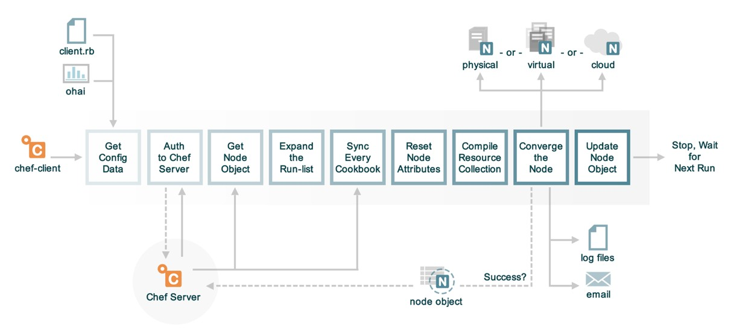
The Chef Client Run
Notes:
When chef-client is executed on the node the first thing that it does is read in configuration from the client.rb file. Shortly after it executes ohai to retrieve the initial list of node attributes. Then the node will authenticate with the Chef Server. The node will receive the last copy of the node object stored on the Chef Server a long with the run list. Expanding the run list is the stage when chef-client will look at the run list and create a complete list of all the recipes it will apply to the node. Every recipe is defined within a cookbook so chef-client will retrieve all the necessary cookbooks.
Now the chef-client run has the attributes defined in the original node object, the new node attributes discovered by Ohai, attributes defined in cookbooks, and attributes defined in roles and environments. All attributes are reset and merged together respecting their particular merge order precedence. Then all the recipes in the run list are loaded and a huge resource collection is created. Then starting at the top of the resource collection chef-client executes each of the defined resources. Until finally it fails or succeeds.
Upon failure an error is generated and NO node object is sent to the Chef Server.
Upon success the node object is sent to the Chef Server.

Slide 6
GL: View How chef-client is Configured
Review the overview of the chef-client run
Review the chef-client configuration file
Notes:
One of the first things that chef-client loads during a chef-client run is the client configuration. This file contains a number of important settings.

Slide 7
GL: View chef-client config Directory
> knife winrm role:web –a cloud.public_ipv4 -x USER -P PWD "dir C:\chef\client.rb"
54.146.147.44 Volume in drive C has no label.
54.146.147.44 Volume Serial Number is D4E5-7A7A
54.146.147.44
54.146.147.44 Directory of C:\chef
54.146.147.44
54.146.147.44 09/20/2018 06:05 PM 332 client.rb
54.146.147.44 1 File(s) 332 bytes
54.146.147.44 0 Dir(s) 11,205,259,264 bytes free
174.129.71.79 Volume in drive C has no label.
174.129.71.79 Volume Serial Number is D4E5-7A7A
174.129.71.79
174.129.71.79 Directory of C:\chef
174.129.71.79
174.129.71.79 09/20/2018 05:27 PM 332 client.rb …
Notes:
chef-client looks for its configuration information in the directory ‘C:\chef’ by default – although this is configurable itself!
This directory contains, not only its own configuration file (which we’ll look at shortly), but also its key to authenticate with the Chef Server, an Ohai plugins directory and a first-boot.json file. The first-boot.json file is generated from the workstation as part of the initial knife bootstrap subcommand, and contains the initial runlist that chef-client should run after Chef has been installed, and before it first registers with the Chef Server.
Note: Spaces were added after 'PWD" in the command example above to avoid visual word wrap. Here is the full command:
knife winrm role:web -a cloud.public_ipv4 -x USER -P PWD "dir C:\chef\client.rb"

Slide 8
GL: View chef-client Configuration
> knife winrm role:web –a cloud.public_ipv4 -x USER -P PWD "type C:\chef\client.rb"
54.146.147.44 chef_server_url "https://api.chef.io/organizations/janesmith11org"
54.146.147.44 validation_
54.146.147.44 client_name "chef-validator"
54.146.147.44 file_cache_path "c:/chef/cache"
54.146.147.44 file_backup_path "c:/chef/backup"
54.146.147.44 cache_options ({:path => "c:/chef/cache/checksums", :skip_expires => true})
54.146.147.44 node_name ”web2"
54.146.147.44 log_level :info
54.146.147.44 log_location STDOUT
174.129.71.79 chef_server_url "https://api.chef.io/organizations/janesmith11org"
174.129.71.79 validation_
174.129.71.79 client_name "chef-validator"
174.129.71.79 file_cache_path "c:/chef/cache"
174.129.71.79 file_backup_path "c:/chef/backup" …
Notes:
The configuration file for chef-client is ‘C:\chef\client.rb’. This file contains the URL for the Chef Server that chef-client should communicate with, i.e. the API endpoint. The validation_client_name parameter is only used with older versions of Chef Server to define what key is used for the initial authentication with the Chef Server. The file also contains the name of the node, which is used to identify the node on the Chef Server, as well as chef-client’s log level and log location.
Note: Spaces were added after 'PWD" in the command example above to avoid visual word wrap. Here is the full command:
knife winrm role:web –a cloud.public_ipv4 -x USER -P PWD "type C:\chef\client.rb"

Slide 9
GL: View How chef-client is Configured
Review the overview of the chef-client run
Review the chef-client configuration file
Notes:
Before we answer those questions we need to spend time learning about how chef-client works.

Slide 10
Managing chef-client
chef-client is a complicated application. Reviewing the conceptual flow of the application and the location of the configuration file helps make it easier to understand. However, there is still much more to learn if you wanted to manage it with a recipe defined in a cookbook.
Notes:
With a brief introduction to chef-client we can see what takes place when we run the application and the configuration file it utilizes. However, that is probably not enough information for us to start writing recipes to solve this problem. And fortunately we don't have to because it has already.

Slide 11
Community Cookbooks
Someone already wrote that cookbook?
Available through the community site called Supermarket
https://supermarket.chef.io
Notes:
What if we told you someone already wrote that cookbook you need?
Someone already has and that cookbook is available through the community site called Supermarket. Supermarket is a public repository of all the cookbooks shared by other developers, teams, and companies who want to share their knowledge and hard work with you to save you time.

Slide 12
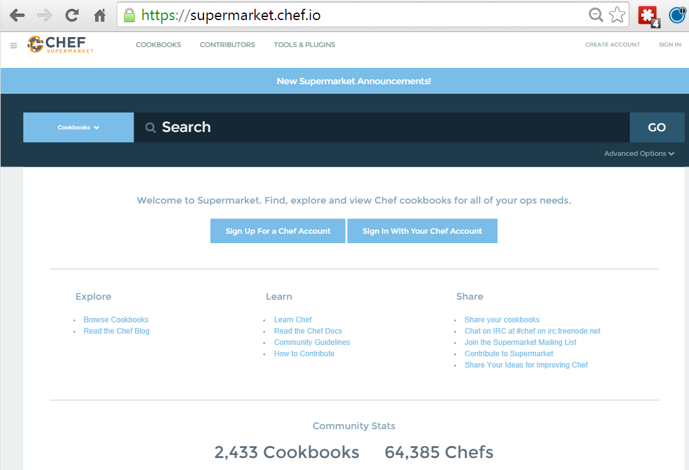
Demo: Community Cookbooks
Community cookbooks are managed by individuals.
Chef does not verify or approve cookbooks in the Supermarket.
Cookbooks may not work for various reasons.
Still, there are real benefits to community cookbooks.
Notes:
An important thing to remember is that on the community site are cookbooks managed by individuals. Chef does not verify or approve the cookbooks found in the Supermarket. These cookbooks solved problems for the original authors and then they decided to share them. This means that the cookbooks you find in the Supermarket may not be built or designed for your platform. It may not take into special consideration your needs and requirements. It may no longer be actively maintained.
Even if the cookbook does not work as a whole, there is still value in reading and understanding the source code and extracting the pieces you need when creating your own. With all that said, there is a real benefit to the community site. When you find a cookbook that helps you deliver value quickly, it can be a tremendous boon to your productivity. This is what we are going to take advantage of with the chef-client cookbook.

Slide 13
Introducing the chef-client Cookbook
The chef-client cookbook allows you to manage and configure chef-client as a service on Linux-based nodes, or as a task on Windows nodes, configure logging, caching, etc.
Bootstrapping installs the chef-client executable.
The chef-client cookbook is used to configure chef-client.

Slide 14
Introducing chef-client Cookbook
We will use the chef-client community cookbook to configure chef-client on each of our nodes to run periodically
Create a cookbook that wraps the chef-client cookbook
Upload chef-client cookbook to Chef Server
Configure each nodes to run chef-client as a service
Converge each node and verify the service is running
Notes:
We want to use the chef-client cookbook. Before we introduce it into our organization we should first talk about wrapping the cookbook. A process which ensures that we can maintain control over it as the needs of that project and us diverge.

Slide 15
Wrapper Cookbooks
Don't use forked community cookbooks in production, or you will miss out on upstream changes, and will have to rebase
Instead use wrapper cookbooks to wrap upstream cookbooks and change their behavior without forking
Notes:
See https://www.chef.io/blog/2013/12/03/doing-wrapper-cookbooks-right/

Slide 16
Supermarket Cookbooks
Wrapper Cookbook
(New additional attributes)
A wrapper cookbook is a new cookbook that encapsulates the functionality of the original cookbook.
It defines new default values for the recipes.
chef-client
cookbook
(Attributes)
https://docs.chef.io/supermarket.html#wrapper-cookbooks
https://www.chef.io/blog/2013/12/03/doing-wrapper-cookbooks-right/
Notes:
A wrapper cookbook is a new cookbook that encapsulates the functionality of the original cookbook but allows us to define new default values for the recipes.
This is a common method for overriding cookbooks because it allows us to leave the original cookbook untouched. We simply provide new default values that we want and then include the recipes that we want to run.
Let's generate our wrapper cookbook named myiis_lb. Traditionally we would name the cookbook with a prefix of the name of our company and then follow it by the cookbook name 'company-cookbook'.

Slide 17
GL: Create my_chef_client Wrapper Cookbook
> cd chef-repo
> chef generate cookbook cookbooks\my_chef_client
Generating cookbook my_chef_client
- Ensuring correct cookbook file content
- Committing cookbook files to git
- Ensuring delivery configuration
- Ensuring correct delivery build cookbook content
- Adding delivery configuration to feature branch
- Adding build cookbook to feature branch
- Merging delivery content feature branch to master
Your cookbook is ready. Type `cd cookbooks\my_chef_client` to enter it.
...
Notes:
Change to your chef-repo directory and then generate your new cookbook.
Instructor Note: The generate cookbook command needs the path in the name of the cookbook here to ensure that it generates the cookbook in the cookbooks directory. Without it the cookbook will be generated within the root of the chef repository. If that happens simply have the learner move the newly generated cookbook into the cookbooks directory.

Slide 18
GL: Edit my_chef_client Default Recipe
~\chef-repo\cookbooks\my_chef_client\recipes\default.rb
#
# Cookbook Name:: my_chef_client
# Recipe:: default
#
# Copyright (c) 2018 The Authors, All Rights Reserved.
include_recipe 'chef-client::default'
This recipe just calls the recipe chef-client::default

Slide 19
GL: Update my_chef_client metadata.rb
~\chef-repo\cookbooks\my_chef_client\metadata.rb
name 'my_chef_client'
maintainer 'The Authors'
maintainer_email 'you@example.com'
license 'all_rights'
description 'Installs/Configures my_chef_client'
long_description 'Installs/Configures my_chef_client'
version '0.1.0'
depends 'chef-client'

Slide 20
Introducing chef-client Cookbook
We will use the chef-client community cookbook to configure chef-client on each of our nodes to run periodically
Create a cookbook that wraps the chef-client cookbook
Upload chef-client cookbook to Chef Server
Configure each nodes to run chef-client as a service
Converge each node and verify the service is running
Notes:
With the cookbook wrapped and ready to go. It is time to upload it to the Chef Server.

Slide 21
GL: Install the Dependencies
> cd cookbooks\my_chef_client
> berks install
Resolving cookbook dependencies...
Fetching 'my_chef_client' from source at .
Fetching cookbook index from https://supermarket.chef.io...
Using chef-client (8.1.8)
Using logrotate (2.2.0)
Using my_chef_client (0.1.0) from source at .
Using ohai (5.2.0)
Installing windows (3.1.3)
Using compat_resource (12.19.0)
Using cron (4.1.3)

Slide 22
GL: View Berksfile.lock
> gc Berksfile.lock
DEPENDENCIES
my_chef_client
path: .
metadata: true
GRAPH
chef-client (8.1.8)
cron (>= 2.0.0)
logrotate (>= 1.9.0)
windows (>= 2.0.0)
compat_resource (12.19.0)
cron (4.1.3)
compat_resource (>= 0.0.0)….

Slide 23
GL: View the Berkshelf in Your Home Directory
> dir ~\.berkshelf\cookbooks
drwxr-xr-x 12 YOU staff 408 2 Dec 15:46 chef_handler-1.1.6
drwxr-xr-x 12 YOU staff 408 2 Dec 15:46 cron-1.6.1
drwxr-xr-x 21 YOU staff 714 2 Dec 15:46 logrotate-1.8.0
drwxr-xr-x 15 YOU staff 510 2 Dec 15:46 windows-1.36.6
drwxr-xr-x 9 YOU staff 306 28 Nov 15:22 build-essential-2.1.3
drwxr-xr-x 25 YOU staff 850 6 Nov 16:27 build-essential-2.1.2
drwxr-xr-x 11 YOU staff 374 6 Nov 16:27 cpu-0.2.0
Note: Windows users can also use `ls -force ~\.berkshelf\cookbooks`
Notes:
Berkshelf does not store dependent cookbook in the actual repo you’re working in, but puts them in another location, usually under your home directory. This means your repo is not polluted with cookbooks that you neither need nor want. For example, the chef-client cookbook is designed to be multiplatform, and will work on all flavors of Linux as well as Windows. However, if you’re a Linux shop you may not want Windows specific dependencies in your working repo.

Slide 24
GL: Upload Cookbooks to Chef Server
> berks upload
Uploaded chef-client (8.1.8) to: 'https://api.chef.io:443/organizations/awesomestudent'
Uploaded compat_resource (12.19.0) to: 'https://api.chef.io:443/organizations/awesomestudent'

Slide 25
GL: View Cookbooks on Chef Server
> knife cookbook list
chef-client 8.1.8
compat_resource 12.19.0
cron 4.1.3
logrotate 2.2.0
my_chef_client 0.1.0
myiis 0.2.1
ohai 5.2.0
windows 3.1.3
workstation 0.1.0

Slide 26
Introducing chef-client Cookbook
We will use the chef-client community cookbook to configure chef-client on each of our nodes to run periodically
Create a cookbook that wraps the chef-client cookbook
Upload chef-client cookbook to Chef Server
Configure each nodes to run chef-client as a service
Converge each node and verify the service is running
Notes:
The cookbook has been uploaded. It is time to now configure each node to run chef-client as a service.

Slide 27
Lets Examine the chef-client Cookbook
We're going to use one recipe on our node from the chef-client cookbook.
chef-client::service (via chef-client::default)

Slide 28
GL: View the chef-client::default Recipe
~\.berkshelf\cookbooks\chef-client-<version>\recipes\default.rb
#
# Unless required by applicable law or agreed to in writing, software
# distributed under the License is distributed on an "AS IS" BASIS,
# WITHOUT WARRANTIES OR CONDITIONS OF ANY KIND, either express or implied.
# See the License for the specific language governing permissions and
# limitations under the License.
#
if platform?('windows')
include_recipe 'chef-client::task'
else
include_recipe 'chef-client::service'
end
Notes:
The default recipe just makes a call to the recipe ‘chef-client::service’--this is the recipe that will set chef-client to run as a service.

Slide 29
chef-client as a Service
We will add the chef-client default recipe to the roles for each node.

Slide 30
GL: Create the new ‘base’ role
~\chef-repo\roles\base.rb
name 'base'
description 'Base Role'
run_list 'recipe[my_chef_client]'
Notes:
First we create a file named base.rb in the roles directory.
The name of the role is base. The description should be Base Role. The run list you define should contain the my_chef_client cookbook's default recipe.

Slide 31
GL: Add the base Role to web Role
~\chef-repo\roles\web.rb
name 'web'
description 'Web Server'
run_list 'role[base]','recipe[myiis]'
Notes:
Then we create a file named web.rb in the roles directory.
The name of the role is web. The description should be Web Server. The run list you define should contain the myiis cookbook's default recipe.

Slide 32
GL: Upload the roles File
> cd ~\chef-repo
> knife role from file base.rb web.rb
Updated Role base
Updated Role web
Notes:
You need to share the role with the Chef Server so upload that file.
Use the command 'knife role from file base.rb web.rb'. 'knife' knows where to look for that role to upload it.

Slide 33
Introducing chef-client Cookbook
We will use the chef-client community cookbook to configure chef-client on each of our nodes to run periodically
Create a cookbook that wraps the chef-client cookbook
Upload chef-client cookbook to Chef Server
Configure each nodes to run chef-client as a service
Converge each node and verify the service is running
Notes:
The new base has been created. The web role inherits that base role. Our nodes have already been assigned the web role. It is time to converge each node and then verify the service starts.

Slide 34
GL: Converge All Nodes
> knife winrm role:web -a cloud.public_ipv4 -x USER -P PWD "chef-client"
54.146.147.44 [2018-09-20T21:21:05+00:00] INFO: *** Chef 13.4.24 ***
54.146.147.44 [2018-09-20T21:21:05+00:00] INFO: Platform: x64-mingw32
…
54.146.147.44 [2018-09-20T21:21:09+00:00] INFO: Starting Chef Run for node2
54.146.147.44 [2018-09-20T21:21:09+00:00] INFO: Running start handlers
54.146.147.44 [2018-09-20T21:21:09+00:00] INFO: Start handlers complete
…
174.129.71.79 [2018-09-20T21:21:20+00:00] INFO: Run List is [role[web]]
174.129.71.79 [2018-09-20T21:21:20+00:00] INFO: Run List expands to [my_chef_client, myiis]
174.129.71.79 [2018-09-20T21:21:20+00:00] INFO: Starting Chef Run for web1
Notes:
To converge these nodes, run 'knife winrm' targeting all the nodes with the role web. Each node should report that it is applying the wrapper cookbook's default recipe which was found within the base role.

Slide 35
GL: Verify chef-client is Running
> knife winrm role:web –a cloud.public_ipv4 -x USER -P PWD "schtasks | findstr chef-client"
54.146.147.44 chef-client 9/20/2018 9:51:00 PM Ready
174.129.71.79 chef-client 9/20/2018 9:51:00 PM Ready
Notes:
We can verify that the chef-client application is running as a service by executing this command against all the web nodes.

Slide 36
Introducing chef-client Cookbook
We will use the chef-client community cookbook to configure chef-client on each of our nodes to run periodically
Create a cookbook that wraps the chef-client cookbook
Upload chef-client cookbook to Chef Server
Configure each nodes to run chef-client as a service
Converge each node and verify the service is running
Notes:
The nodes now run chef-client as a service and will converge at a given interval.

Slide 37
chef-client has Default Settings
The chef-client cookbook provides default attributes for a lot of application settings. We can provide new values to override the defaults.

Slide 38
Converge Faster!
Converging every 30 minutes is too slow. Can we make it every 5 minutes?
Find the attribute to override and the location to override it
Override the attribute
Upload the cookbook and converge all nodes with the web role
Notes:
We want to test out overriding these default settings by asking the node to converge every 5 minutes instead of every 30 minutes. To do that we are going to first need to find the value we need to change.

Slide 39
Attribute Files
The Node Object contains many automatic attributes generate by Ohai.
You can also define attributes within a cookbook. These are like variables or parameters for your cookbook and allow recipes to be data driven.
Notes:
The majority of default values for an application are defined in an attributes file within the cookbook. These attribute files contain node attributes that are important to the operation of the cookbook. These attributes are often defined at a particular level that makes them easy to override in another recipe or a role if needed.

Slide 40
GL: Finding the chef-client run Interval Default
~\.berkshelf\cookbooks\chef-client<VER>\attributes\default.rb
...
default['chef_client']['log_file'] = 'client.log'
default['chef_client']['interval'] = '1800'
default['chef_client']['splay'] = '300'
default['chef_client']['conf_dir'] = '/etc/chef'
default['chef_client']['bin'] = '/usr/bin/chef-client'
...
1800 seconds (30 minutes) is the time to wait between converges.
Notes:
This cookbook contains an attributes directory with a default attributes file. Within this file are lots of node attributes having their default values being set. Within the file you will find a value highlighted above. This is the default time interval that the chef-client service waits before checking in against the Chef Server.
So we need to override the attribute default['chef_client']['interval'] that is defined in this attributes file.

Slide 41
Defining Attributes
Notes:
An attribute first defines the precedence level. Which is a measure of how important it is compared to other attributes with a similar name. When there is a attribute name collision the attribute with the highest precedence wins.
The name of the attribute is up to the maintainer of the cookbook to decide. Most often times the first attribute name is the name of the cookbook. This is beneficial because it namespaces the attribute to the cookbook so there are not accidental collisions. It also ensures that other maintainers are able to find this attribute later because they know where the value was initially set.
The value itself can be any Ruby object. Often times it is a String, number, Hash or Array.

Slide 42
Default Attribute Precedence
Please note this is a simplified diagram, and the precedence shown can be overridden.

Slide 43
Full Attribute Precedence

Slide 44
Best Practice: Do Not Fork Community Cookbooks
Unable to grab updated versions of the cookbook without merging
Breaking of default expectations that people come to expect
A small change means a new version; making it even harder to reintegrate when versions collide.
Notes:
The easy solution would be to simply edit the chef-client cookbook. However, editing that cookbook and defining a new default value within the chef-client cookbook means that we have forked our version from the original community cookbook.
In the future, if we wanted to receive updated versions of the chef-client cookbook from the community we would have to make sure that we maintained our changes. Opening that attributes file and editing it each time. Others may come to rely on the defaults in the community cookbook only to find that your version differs. Also when you make a change you have to bump the version number. The version number you choose will eventually become out of synch with what the community is building.
One that is fixed by using the wrapper cookbook that we defined as the place where we will define our new value to override the default.

Slide 45
Converge Faster!
Converging every 30 minutes is too slow. Can we make it every 5 minutes?
Find the attribute to override and the location to override it
Override the attribute
Upload the cookbook and converge all nodes with the web role
Notes:
We found the attribute and learned about attribute along the way. Now it is time to provide a new value for this chef-client service interval.

Slide 46
GL: Edit my_chef_client Default Recipe
~\chef-repo\cookbooks\my_chef_client\recipes\default.rb
#
# Cookbook Name:: my_chef_client
# Recipe:: default
#
# Copyright (c) 2018 The Authors, All Rights Reserved.
node.default['chef_client']['interval'] = '300'
include_recipe 'chef-client::default'
Note 'node.default' notation when setting an attribute value from within a recipe
Notes:
Within the default recipe we can define a new default value. A default value defined in a recipe file will override a default value specified in an attributes file.
Within the attributes file we can use a shorthand notation of expressing the attribute. Within the recipe we have to start this expression out with the node object and a period to show that we are invoking the default attribute precedence as specified on the node object.

Slide 47
Full Attribute Precedence

Slide 48
GL: Update my_chef_client metadata.rb
~\chef-repo\cookbooks\my_chef_client\metadata.rb
name 'my_chef_client'
maintainer 'The Authors'
maintainer_email 'you@example.com'
license 'all_rights'
description 'Installs/Configures my_chef_client'
long_description 'Installs/Configures my_chef_client'
version '0.1.1'
Depends 'chef-client'
Notes:
This change could be considered a bug fix, if we originally intended the interval time to be 5 minutes. It also could be a minor fix. Here, we chosen to define it as a bug fix and update the version accordingly.

Slide 49
Converge Faster!
Converging every 30 minutes is too slow. Can we make it every 5 minutes?
Find the attribute to override and the location to override it
Override the attribute
Upload the cookbook and converge all nodes with the web role
Notes:
We have a new default value defined in a recipe which has a higher precedence and we accomplished this without editing the community cookbook. Now it is time to upload the cookbook.

Slide 50
GL: Run berks install
> cd cookbooks\my_chef_client
> berks install
…
Fetching 'my_chef_client' from source at .
Fetching cookbook index from https://supermarket.chef.io...
Using chef-client (8.1.8)
Using logrotate (2.2.0)
Using my_chef_client (0.1.1) from source at .
Using ohai (5.2.0)
Using windows (3.1.3)
Using compat_resource (12.19.0)
Using cron (4.1.3)
Notes:
Berkshelf is used on a per-cookbook basis. As dependencies are often per cookbook you'll need to change into the directory of the cookbook.
You should install any dependencies that your cookbook might have. Again, in this instance there are no dependencies external to this cookbook but Berkshelf ensures that this is the case when it runs the 'berks install' command.
You'll see that it finds the current cookbook within your current directory, it contacts the Supermarket for any external dependencies, and then ...

Slide 51
GL: Upload the Cookbook to the Chef Server
> berks upload
Skipping chef-client (8.1.8) (frozen)
Skipping compat_resource (12.19.0) (frozen)
Skipping cron (4.1.3) (frozen)
Skipping logrotate (2.2.0) (frozen)
Uploaded my_chef_client (0.1.1) to: 'https://api.chef.io:443/organizations/awesomestudent'
Skipping ohai (5.2.0) (frozen)
Skipping windows (3.1.3) (frozen)
Notes:
With the dependencies accounted for, it is time to upload the cookbook to the Chef Server. This is another sub-command that Berkshelf provides called 'upload'. Run the command to upload the my_chef_client cookbook to the Chef Server.

Slide 52
GL: Converge All Nodes
> knife winrm role:web –a cloud.public_ipv4 -x USER -P PWD "chef-client"
34.196.63.231 [2018-01-24T15:17:50+00:00] INFO: *** Chef 12.13.37 ***
34.196.63.231 [2018-01-24T15:17:50+00:00] INFO: Platform: i386-mingw32
34.196.63.231 [2018-01-24T15:17:50+00:00] INFO: Chef-client pid: 2380
34.196.63.231 [2018-01-24T15:18:28+00:00] INFO: Run List is [role[web]]
34.196.63.231 [2018-01-24T15:18:28+00:00] INFO: Run List expands to [my_chef_client, myiis]
34.196.63.231 [2018-01-24T15:18:28+00:00] INFO: Starting Chef Run for node1
34.196.63.231 [2018-01-24T15:18:28+00:00] INFO: Running start handlers
34.196.63.231 [2018-01-24T15:18:28+00:00] INFO: Start handlers complete.
...
Notes:
To verify that everything is working the same as before, run 'knife winrm' for both of these nodes. In this instance the query syntax is going to find all nodes with the role set to web.

Slide 53
GL: Verify chef-client is Running
> knife winrm role:web –a cloud.public_ipv4 -x USER -P PWD "schtasks | findstr chef-client"
54.146.147.44 chef-client 9/20/2018 9:51:00 PM Ready
174.129.71.79 chef-client 9/20/2018 9:51:00 PM Ready
Notes:
We can verify that the chef-client application is still running. Note that this output does not show the new interval that we set and only ensures that the operation is still running.

Slide 54
Q&A
What questions can we help you answer?
Chef Supermarket
Wrapper Cookbooks
chef-client
node attributes
Notes:
What questions can we help you answer?
In general or about specifically about Chef Supermarket, wrapper cookbooks, chef-client, or node attributes

